Slide 1

executing your unemployment incident response plan
Mike Doyle, Maror Security

Slide 2
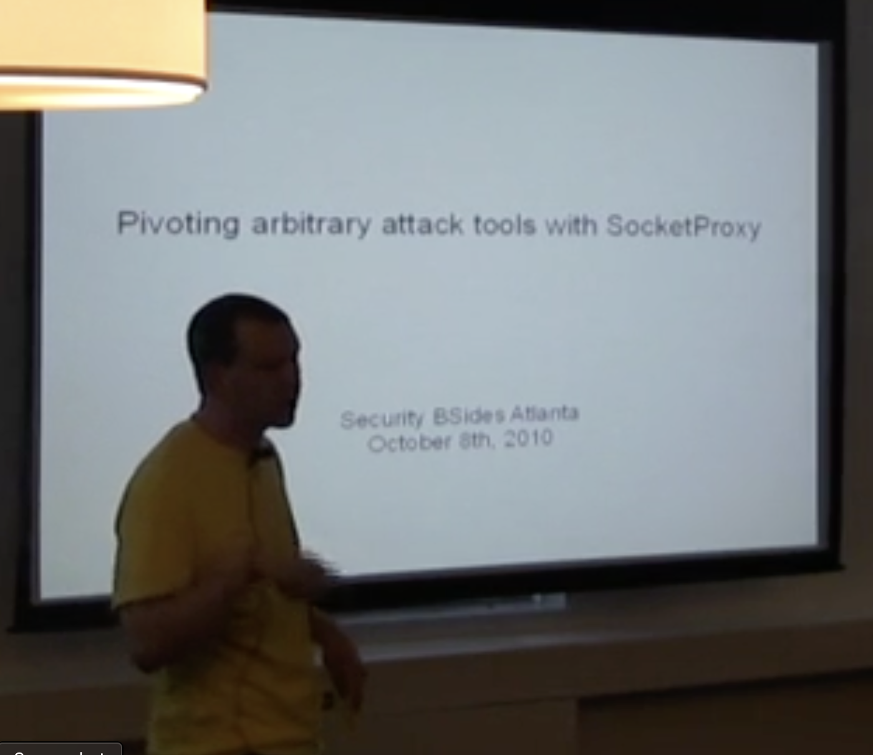
about the speaker
BSidesATL plank owner
Former NetSPI, Cigital, $SNPS, $FLT, construction worker, waiter, barista
BS CS GT ’03
Former Head of Security Research… more on that later…
Founding Principal, Maror Security

Slide 3


Slide 4
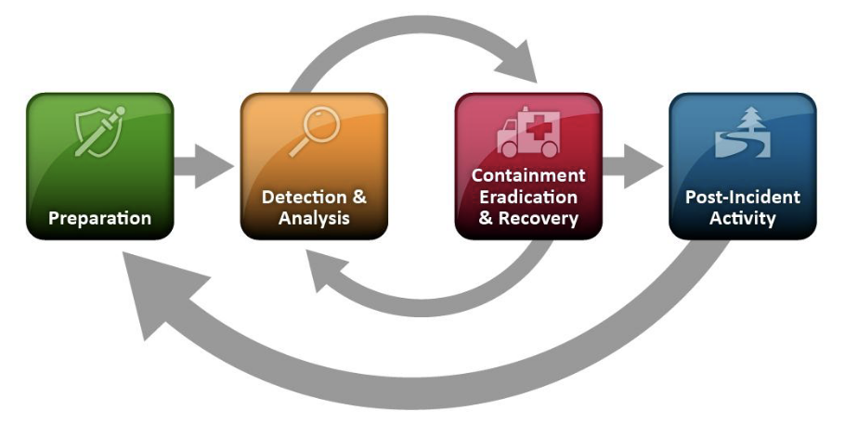

Slide 5


Slide 6
"Steps taken against potential impending risk to provide normalcy for the ones we love.”
Six months take-home pay in liquid assets
A résumé updated within the last quarter
A network that you can flex
Do the best work that you can

Slide 7


Slide 8
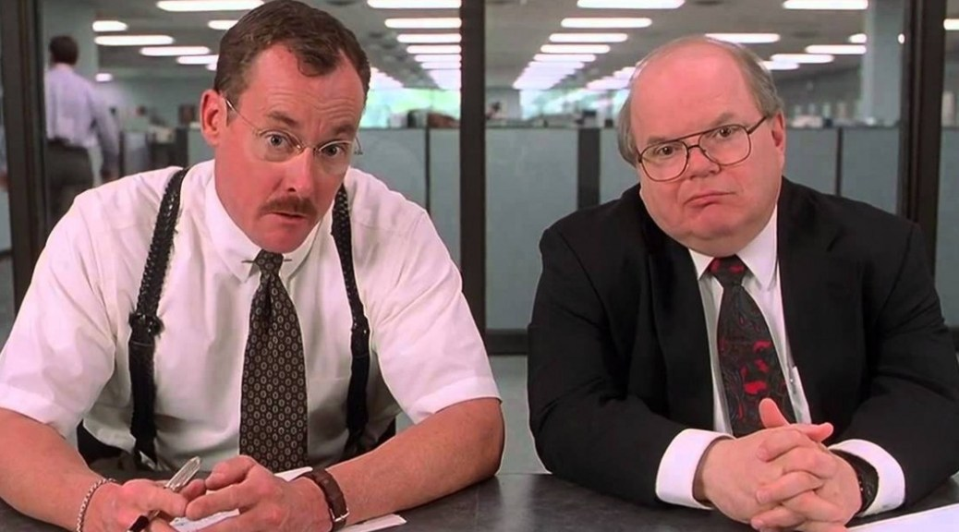

Slide 9
can you pre-cog it tho?

Slide 10


Who knew they were getting cut?

Slide 11
Who knew they were getting cut?
Industry trends
Employer financial health
Performance reviews? Customer feedback?
Boss schedules a vague call on a Thursday afternoon
If you are on a PIP, they already want to fire you

Slide 12


Slide 13
Your Communications Plan
Partner
Kids
Network

Slide 14
Finances
Cut costs while maximizing normalcy
Scrutinize monthly and annual recurring payments
Insurance and COBRA
Do you need to replace perqs you can no longer access?
Unemployment insurance is not a government handout
Your time:money tradeoffs just changed on you, hacker…

Slide 15
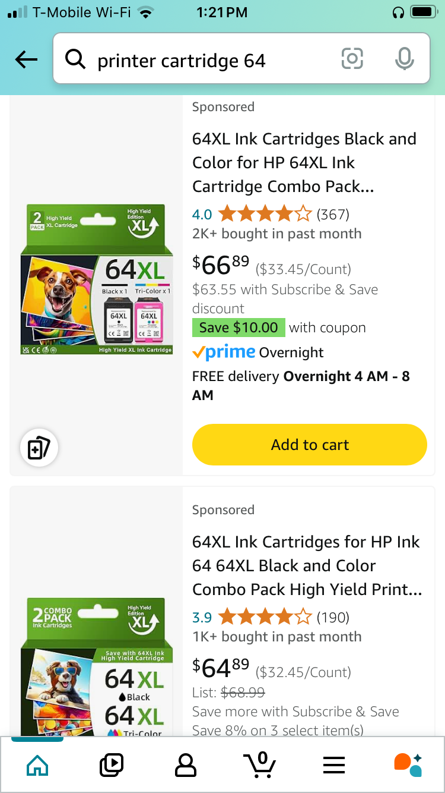
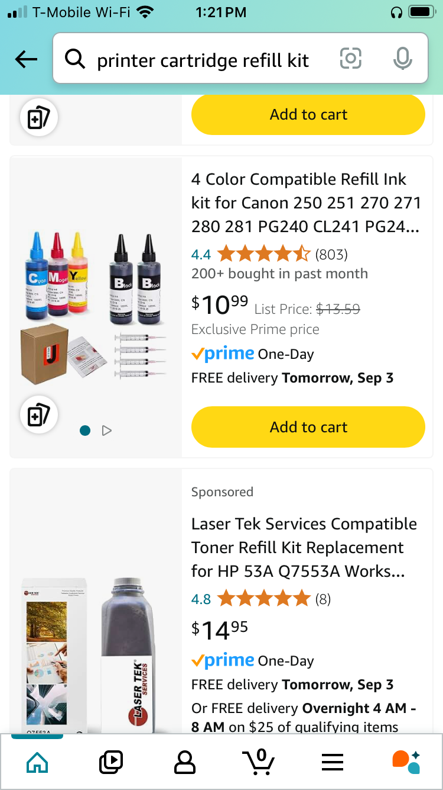
vs

Slide 16


Slide 17
Three habits you need
Exercise
Meditation
Self care
Notes:
Exercise: for mental health, stress, anxiety, energy, sleep, attractiveness all beneficial for getting employed
Meditation: can think on your feet, tremendous for job interviews, also: stress, anger, emotional wellbeing

Slide 18


Slide 19
Substance
Abuse

Slide 20
What else?
Given notice? Do the best work you can
Is now the time to skill up?
Job search taking long?
Cut more expenses
Gig economy revenue streams
Independent consulting

Slide 22
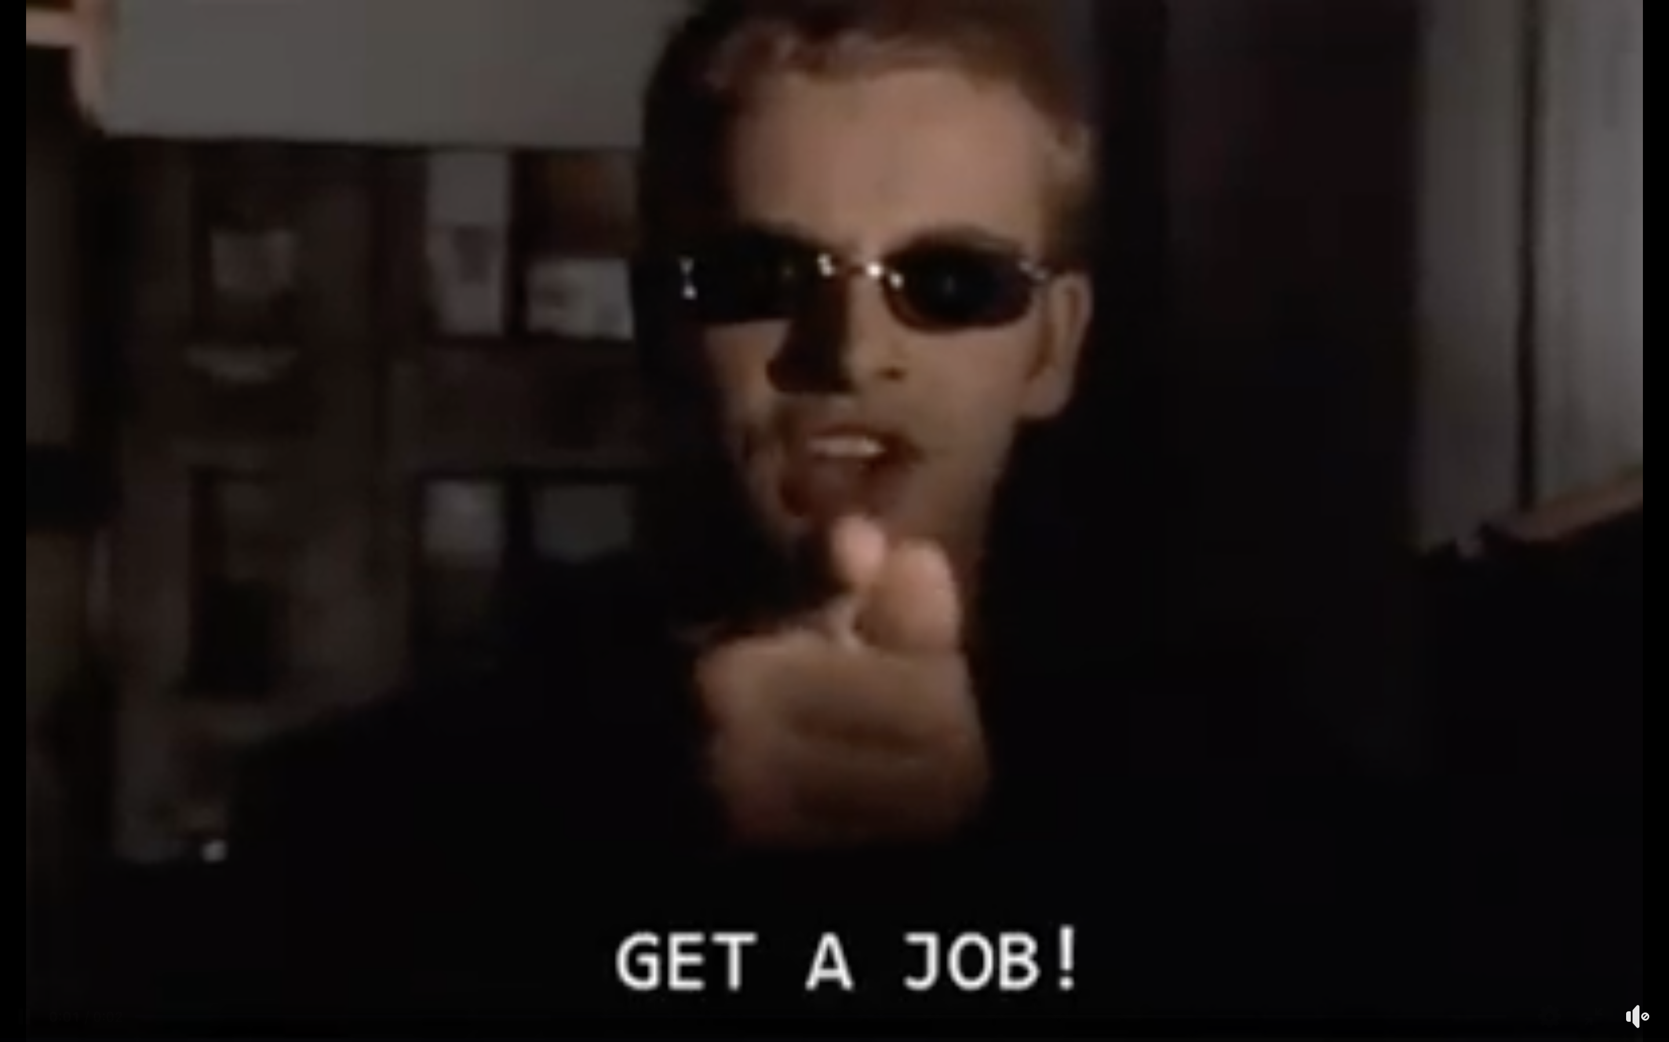

Slide 23


How do people get jobs?

Slide 24
How do people get jobs?
LinkedIn?
Sending resumes?
Someone they used to work with?
Someone they used to go to school with?
Former lover?
Hit the pavement?
Professor Green?
Notes:
Look around the room. We’re gathering data on what might work for you, if you’re more like the people in this room than every one else in the world. This audience participation is more useful than some listicle on linked In..

Slide 25
Interview hints
Research potential employers
Two minutes per resume bullet point, every bullet point
Sip of water trick
Notes:
Improve 2 percent in five different aspects and you’re 10% better.

Slide 26

Interview hints

Slide 27
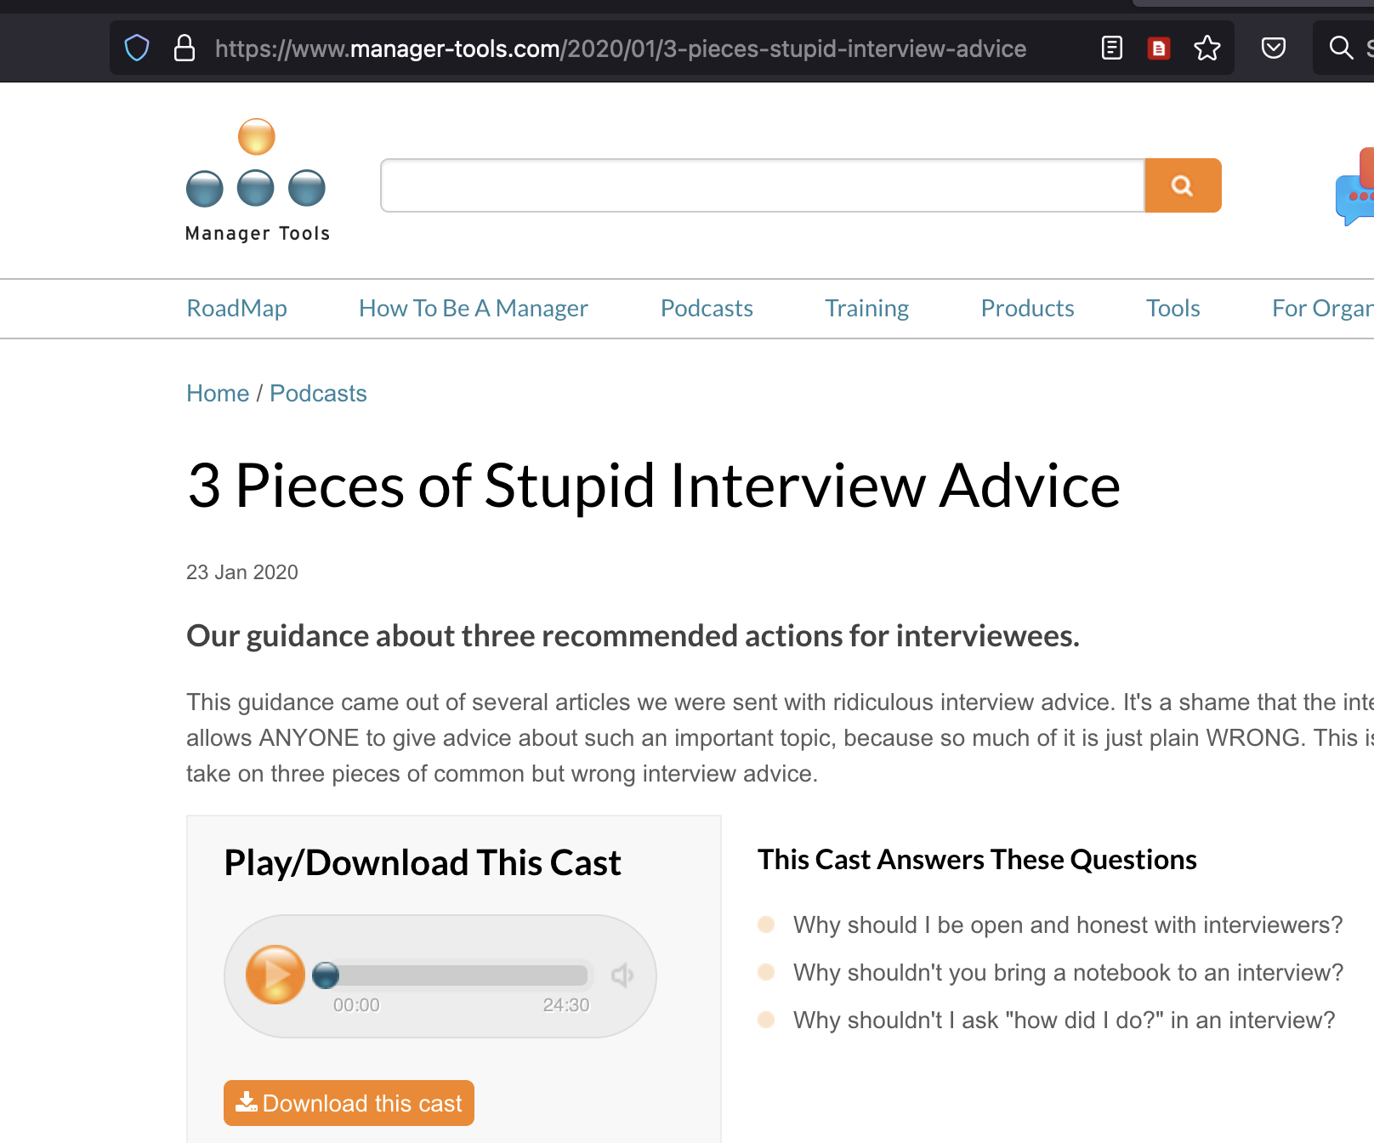
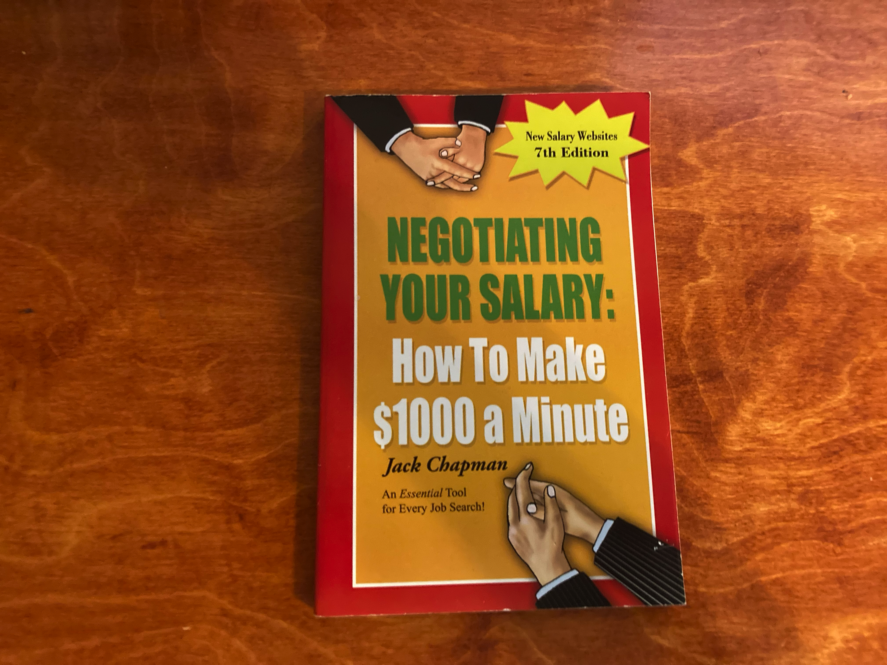
Resources

Slide 29
Recovery
Replenish your savings
Be reluctant to re-introduce entertainment expenses
Do the best work you can

Slide 30


Slide 31
After Action
Keep the daily habits
No one ever complained about too much emergency savings
Calendar the following:
quarterly résumé review
annual review of automatically recurring expenses

Slide 32


Slide 33
Q&A

Slide 34
Thanks! https://marorsecurity.com

